Slide 1


PRESENTATION ON INTERNSHIP PROJECT
HEART FAILURE
Under the guidance of :
Dept of CSE
ATMECE, Mysuru
Presented By :
MOHAMMED ANAD ( 4AD18CS040 )
Project Batch-4

Slide 2
CONTENTS:
1. Overview
2. Technologies Used
3. Module Wise Breakup
4. Explanation
5. Data Extraction
6. Data Cleaning
7. Data Vizualization
8. Summary

Slide 3
OVERVIEW
In medical field, it is seen that irrespective of age, people experience heart problems due to unhealthy lifestyles.
Medical field is considered to treat patients and to provide a better diet and lifestyle. As each sector of the medical is growing, data is building up day by day, we need to keep the record of the data which can be helpful for the analytics and evaluation
This dataset is used to analyze Heart failure.
Before analyzing and visualization we need the raw data, and this raw data can be gathered from different open-source data websites available on the internet like “Kaggle”.
This data will be in raw CSV form, it may be individual subunits of data or the complete dataset containing all the groups of files.
Our project applies principles of data analytics over large existing data sets to effectively predict.
WEBSITE LINK: https://www.kaggle.com/datasets/andrewmvd/heart-failure-clinical-data

Slide 4


TECHNOLOGIES USED
Python
Python is the programming language of choice for data scientists.
Although it wasn't the first primary programming language, its popularity has grown throughout the years.
Jupyter Notebook
It is the original web application for creating and sharing computational documents. It offers a simple, streamlined, document-centric experience.
It is one of the most popular code editors used by data scientists today.
Its application makes creating and sharing notebooks simple, as well as performing end-to-end data science workflows in a single document

Slide 5




TECHNOLOGIES USED CONT…
LIBRARIES IMPORTED
NumPy is a library used for working with arrays
Pandas is used for data science/data analysis and machine learning tasks.
Matplotlib is a comprehensive library for creating static, animated, and interactive visualizations in Python
Seaborn is a data visualization library based on matplotlib.

Slide 6
MODULE WISE BREAKUP
Data analysis contains the following stages:
IDENTIFY
COLLECT
ANALYZE
CLEAN
INTERPRET
It defines the organizational goals, and planning a lucrative solution is the first step in the analytics process.
It is need to collect transactional business data and customer-related information from the past few years to address the problems your business is facing.
It is the data you collect will often be disorderly, messy, and contain unwanted missing values
It is to gather the right data, the next vital step is to execute exploratory data analysis
It is the final step is to interpret the results and validate if the outcomes meet your expectations
6

Slide 7
EXPLAINATION
In this module we first gather data (dataset). Data comes in all forms, most of it being very messy and unstructured. They rarely come ready to use.
Datasets are either large and small, and comes with a variety of issues, invalid fields, missing and additional values, and values that are in forms different from the one we require.
In order to bring it to workable or structured form, we need to “clean” our data, and make it ready to use.
This dataset is used to analyze heart problem reasons.
We will analyze the dataset and we will perform some of the Data cleaning operation, and then we will plot the graphs based on the observation.

Slide 8
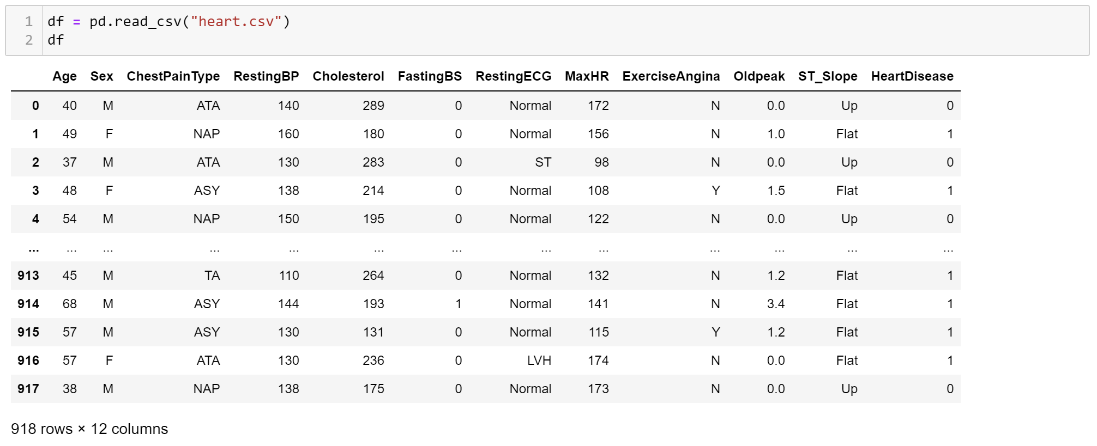
EXTRACTING THE DATA
Is to import the dataset with the help of read_csv() function we are importing csv file to variable name dataset.

Slide 9
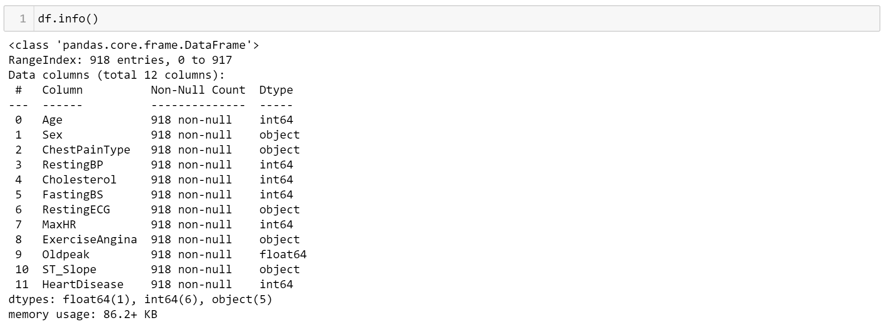
DATA CLEANING
info()
The data has no null values and according to the standard deviation, there are no wrong, outlier data.
It also we can able to see the List of column’s.
It also we can able to see the there is no null values.

Slide 10
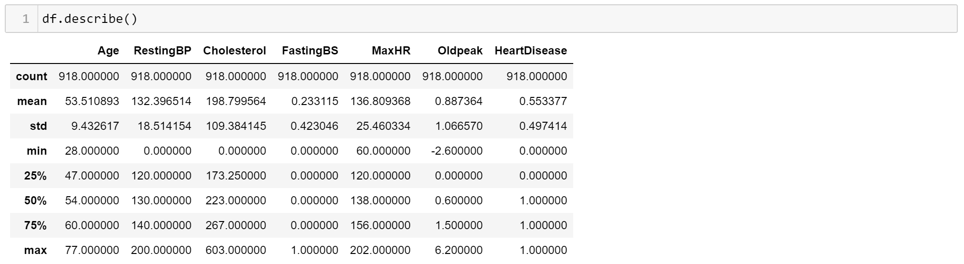
DATA CLEANING CONT…
describe()
From the above figure we can see that using the describe() function.
We can able to clean the data in as mean,median ,min,max etc.
Only we will get the above values if the column contains numerical values.

Slide 11
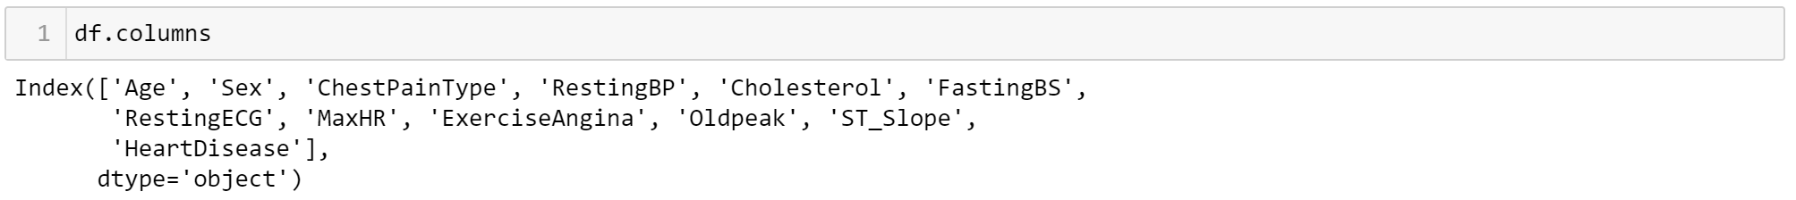
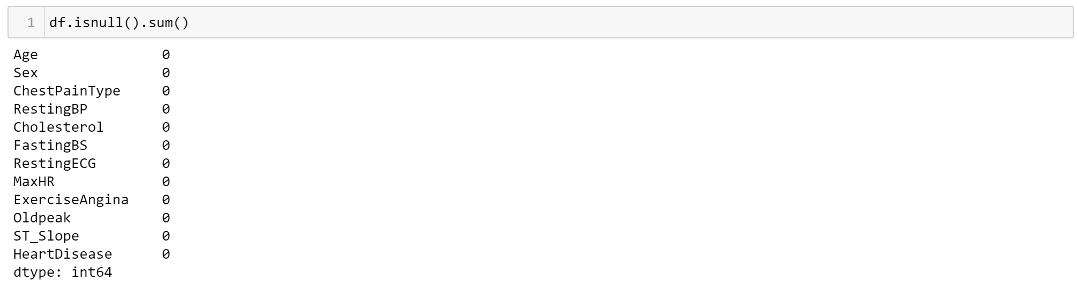
DATA CLEANING CONT…
columns()
Columns present in CSV file
dupicated()
There is no Duplicated values
isnull()
Isnull is represented

Slide 12
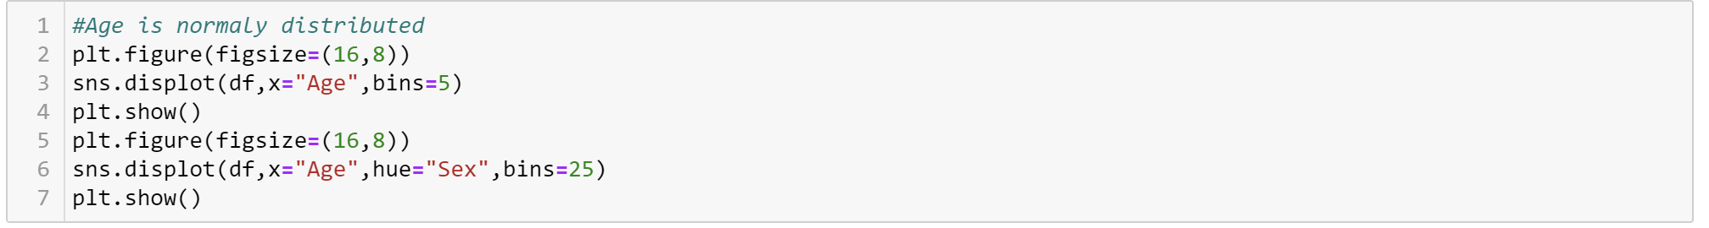
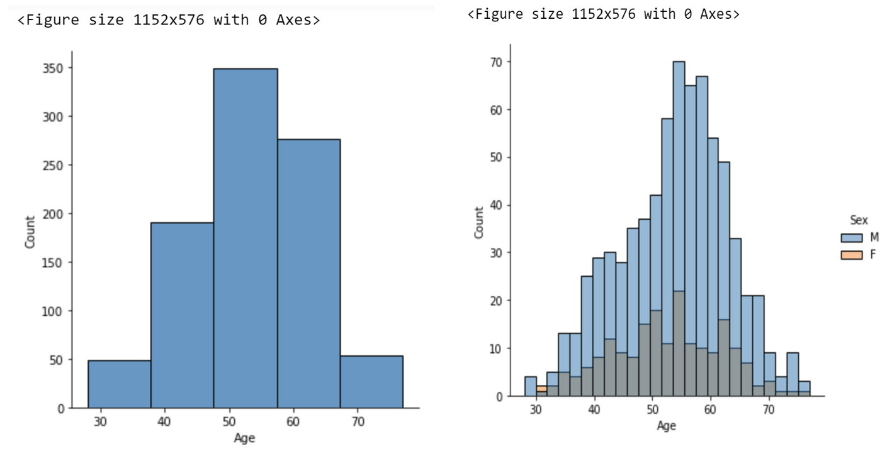
DATA VIZUALIZATION
DISTPLOT
Graph is plotted using Distplot

Slide 13
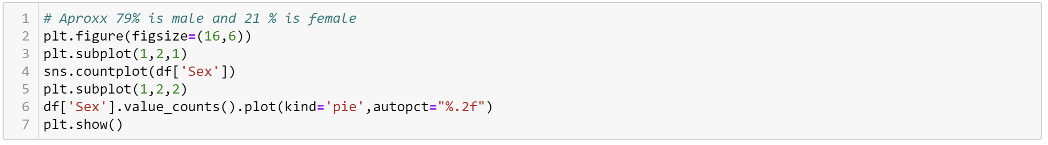
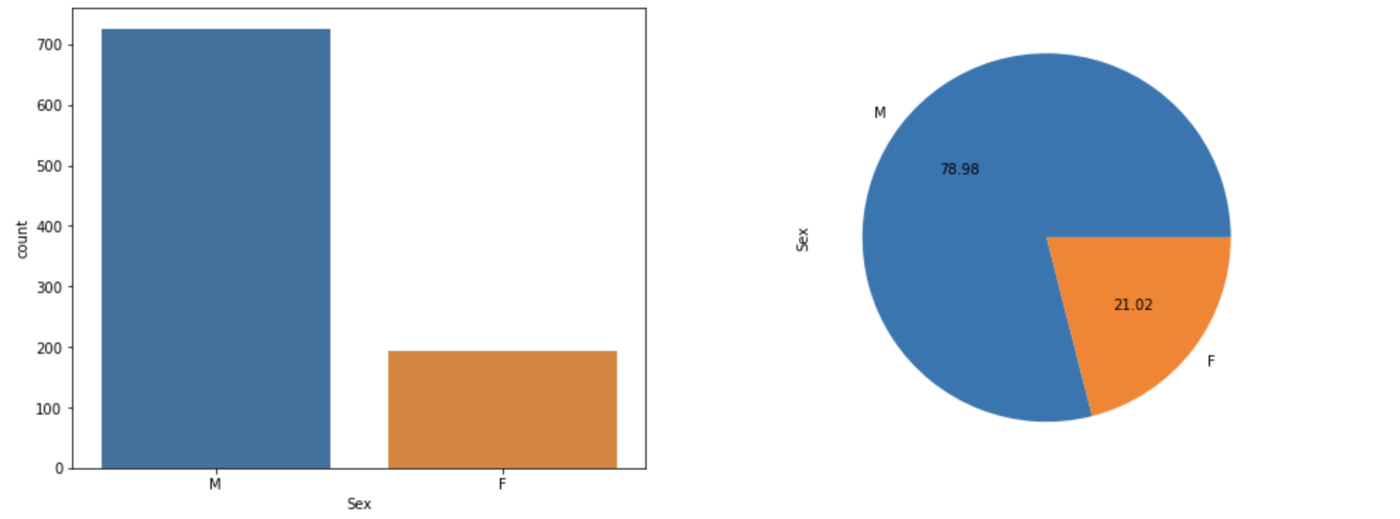
DATA VIZUALIZATION CONT…
COUNTPLOT
Categories genders consisting of both Bar graph and Pie chart

Slide 14
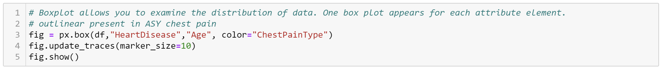
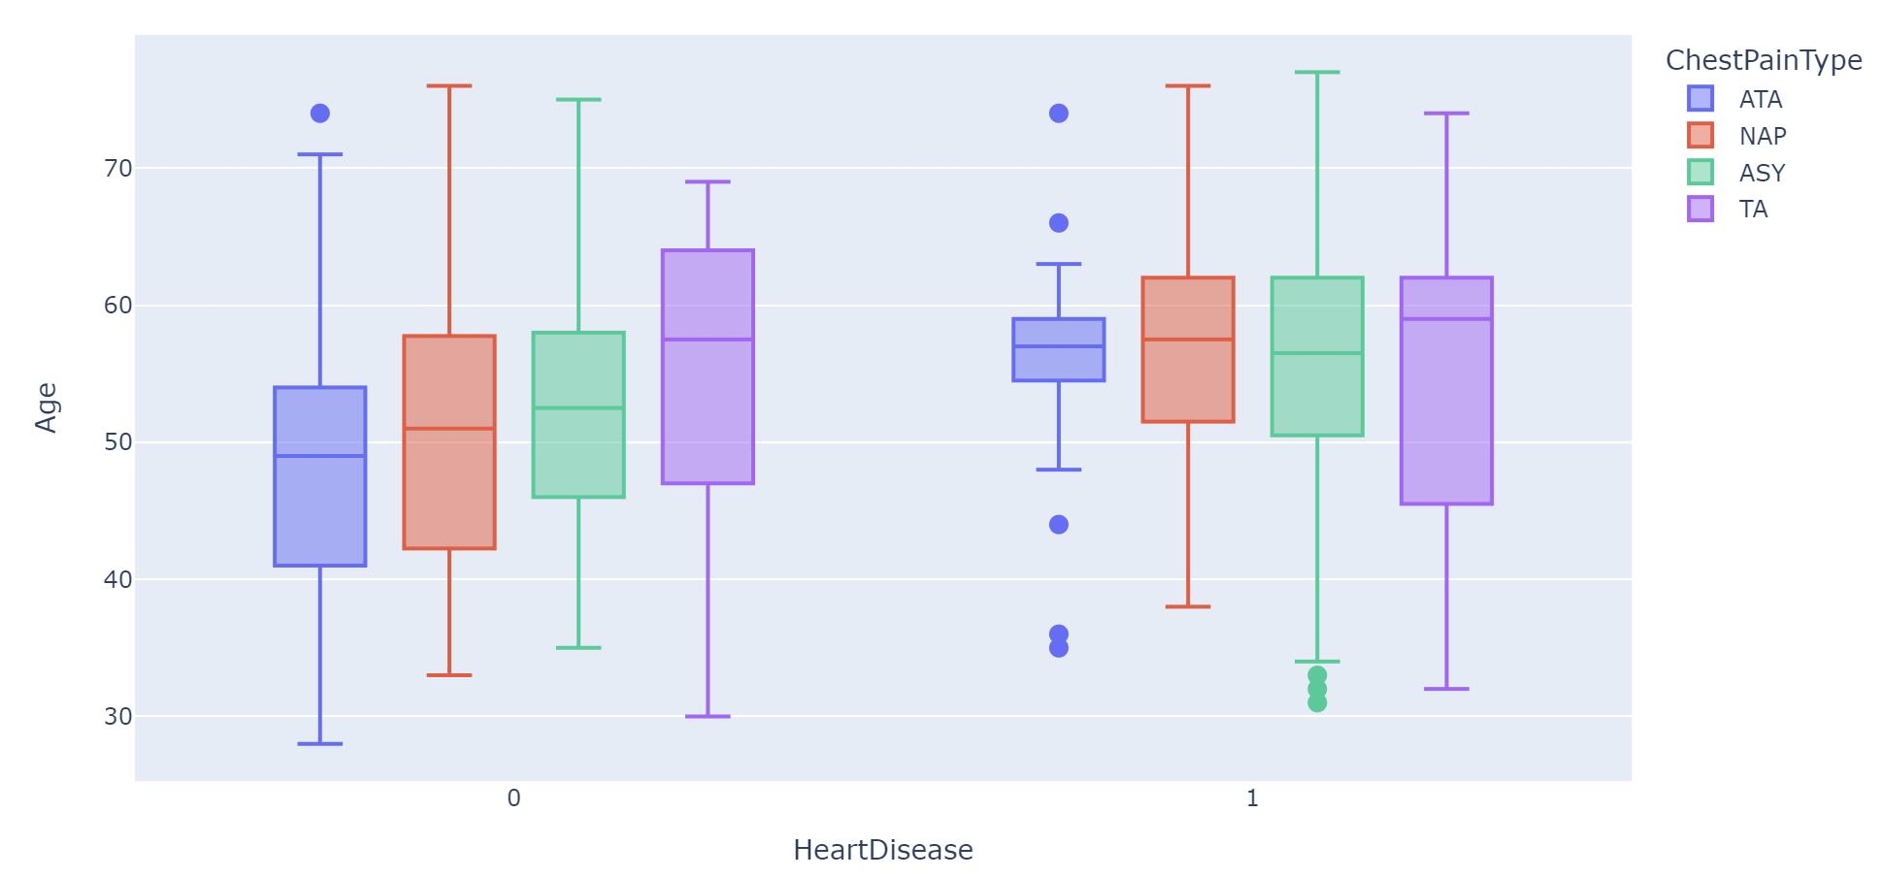
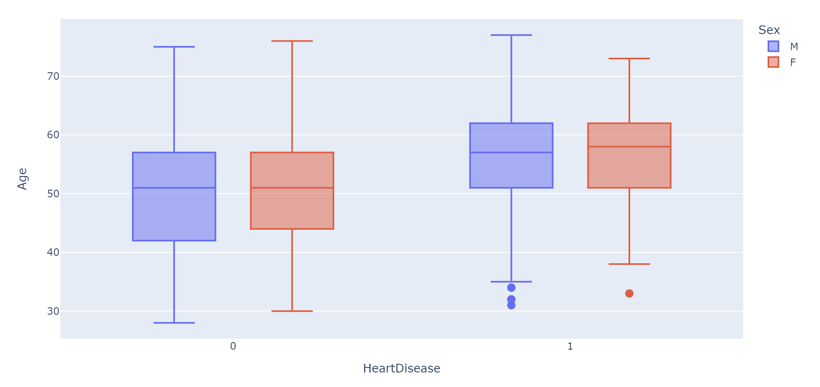
DATA VIZUALIZATION CONT…
BOXPLOT
Box plot based on Heart disease Vs Age
withChest Pain Type as a reference
Box plot based on Heart disease Vs Age
with Sex as a reference

Slide 15
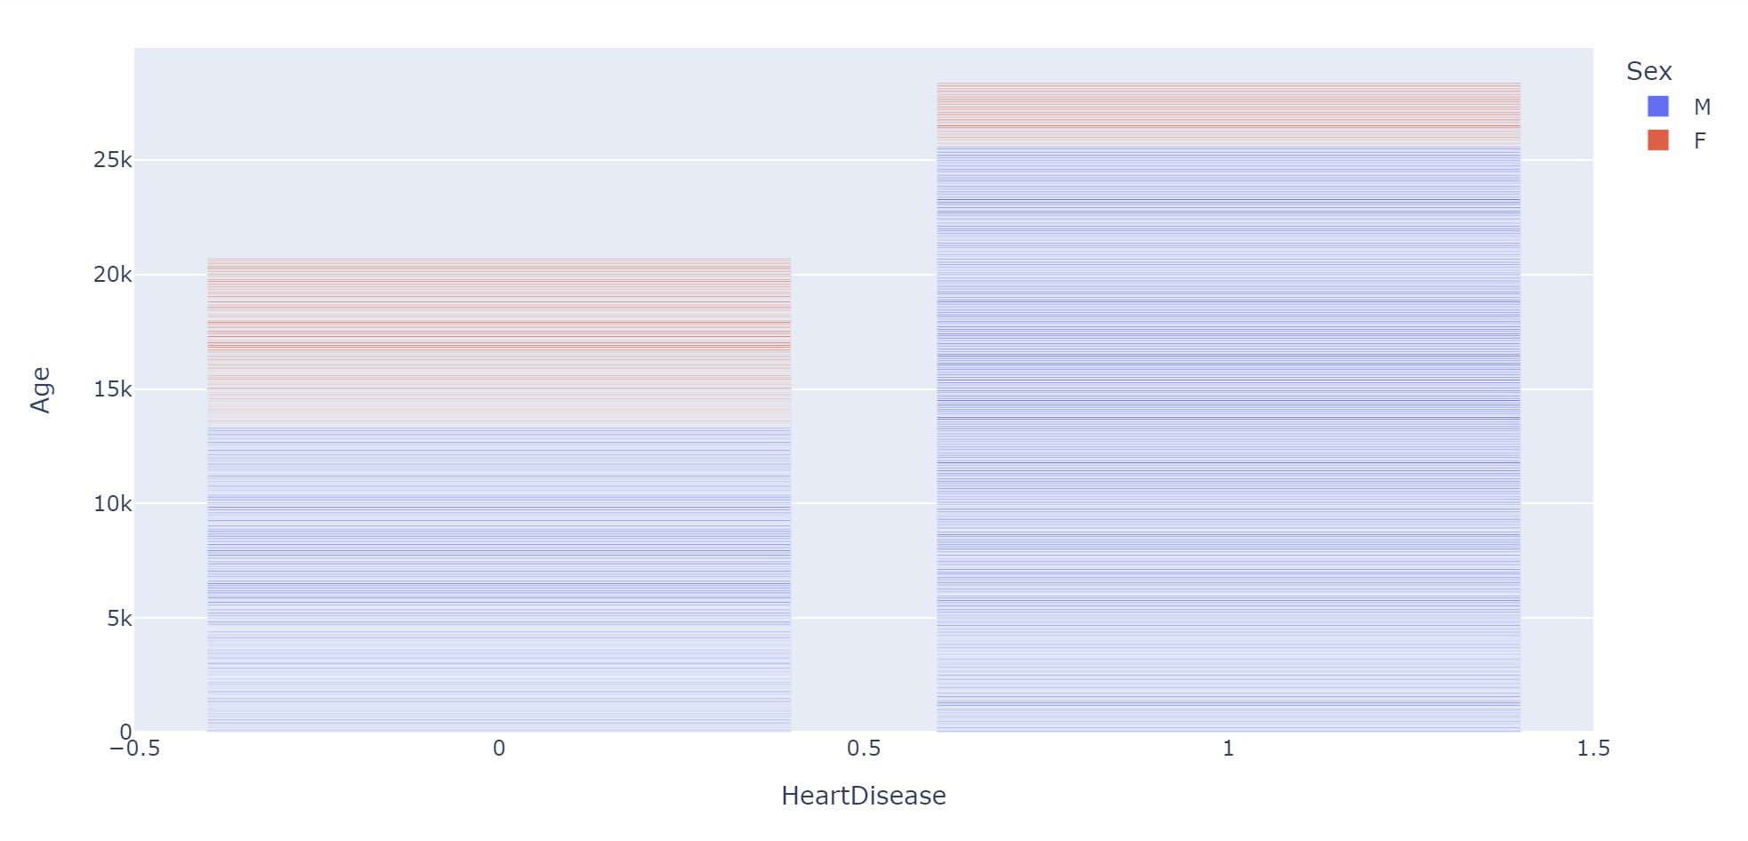
DATA VIZUALIZATION CONT…
BARGRAPH
Shows which gender is likely to have heart disease

Slide 16
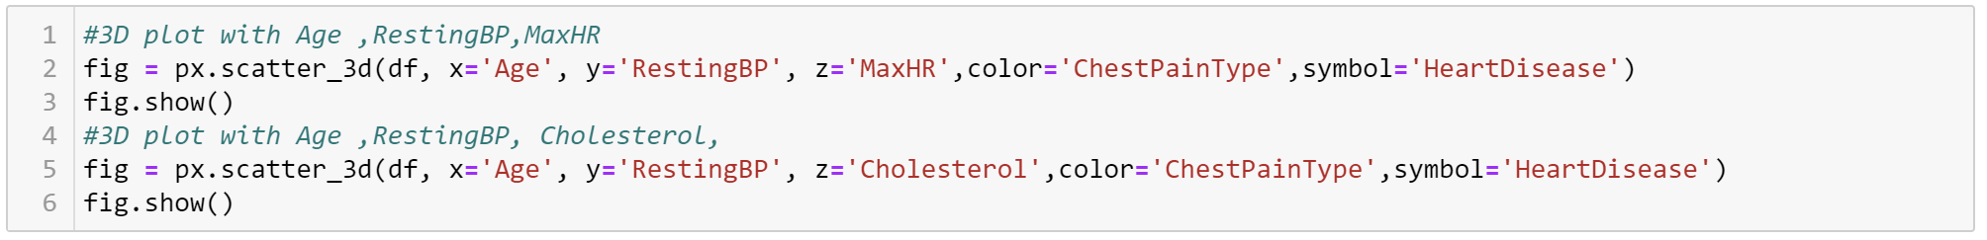
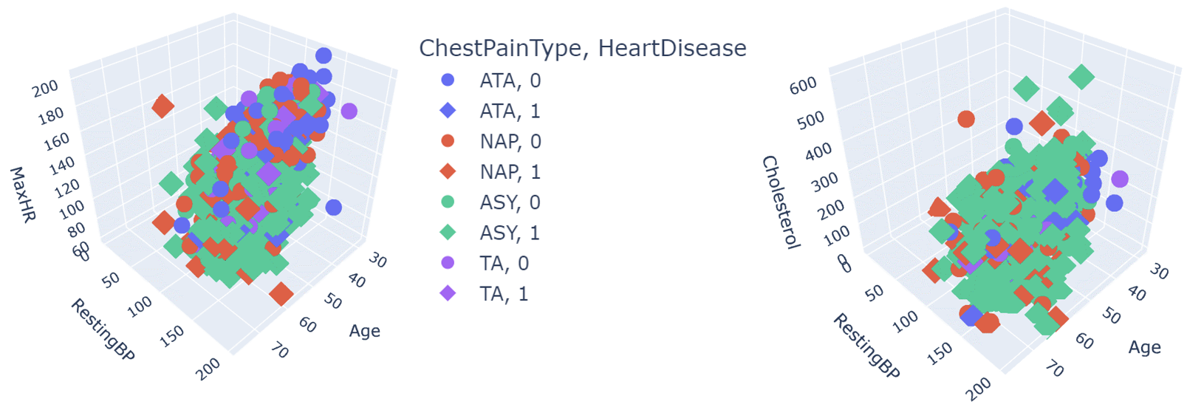
DATA VIZUALIZATION CONT…
3D GRAPH
3D graph based on Age, RestingBP and MaxHR
3D graph based on Age, RestingBP and Cholesterol

Slide 17
SUMMARY
This project applies principles of data analytics over large existing data sets for Heart Failure to know what is the main reason for Heart Failure.
Here are few suggestions which is purely based on subjective & objective data analysis of Heart Failure.
According to the dataset, good health of any human being depends on their individual lifestyle.
The availability of a particular healthy lifestyles such as diet and exercise should be encouraged by medical professionals to patients which provides with an overall good health and reduces heart problems.

Slide 18
NOTE This project is converted into “Menu Driven Program” This we be explained.

Slide 19


